Slide 1
ETHICAL HACKING TASK 2
-By Neil Uri Nowgaonkar

Slide 2
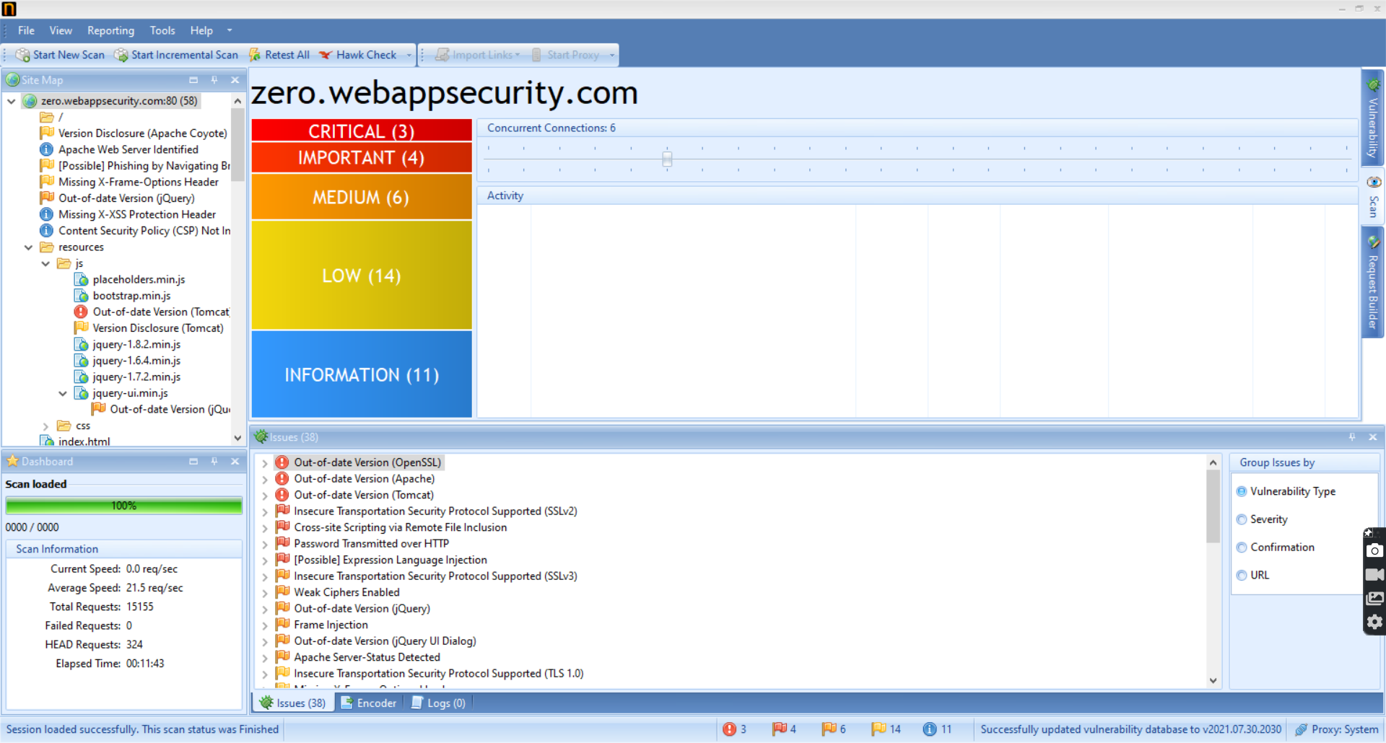
Netsparker Found Vulnerabilities

Slide 3
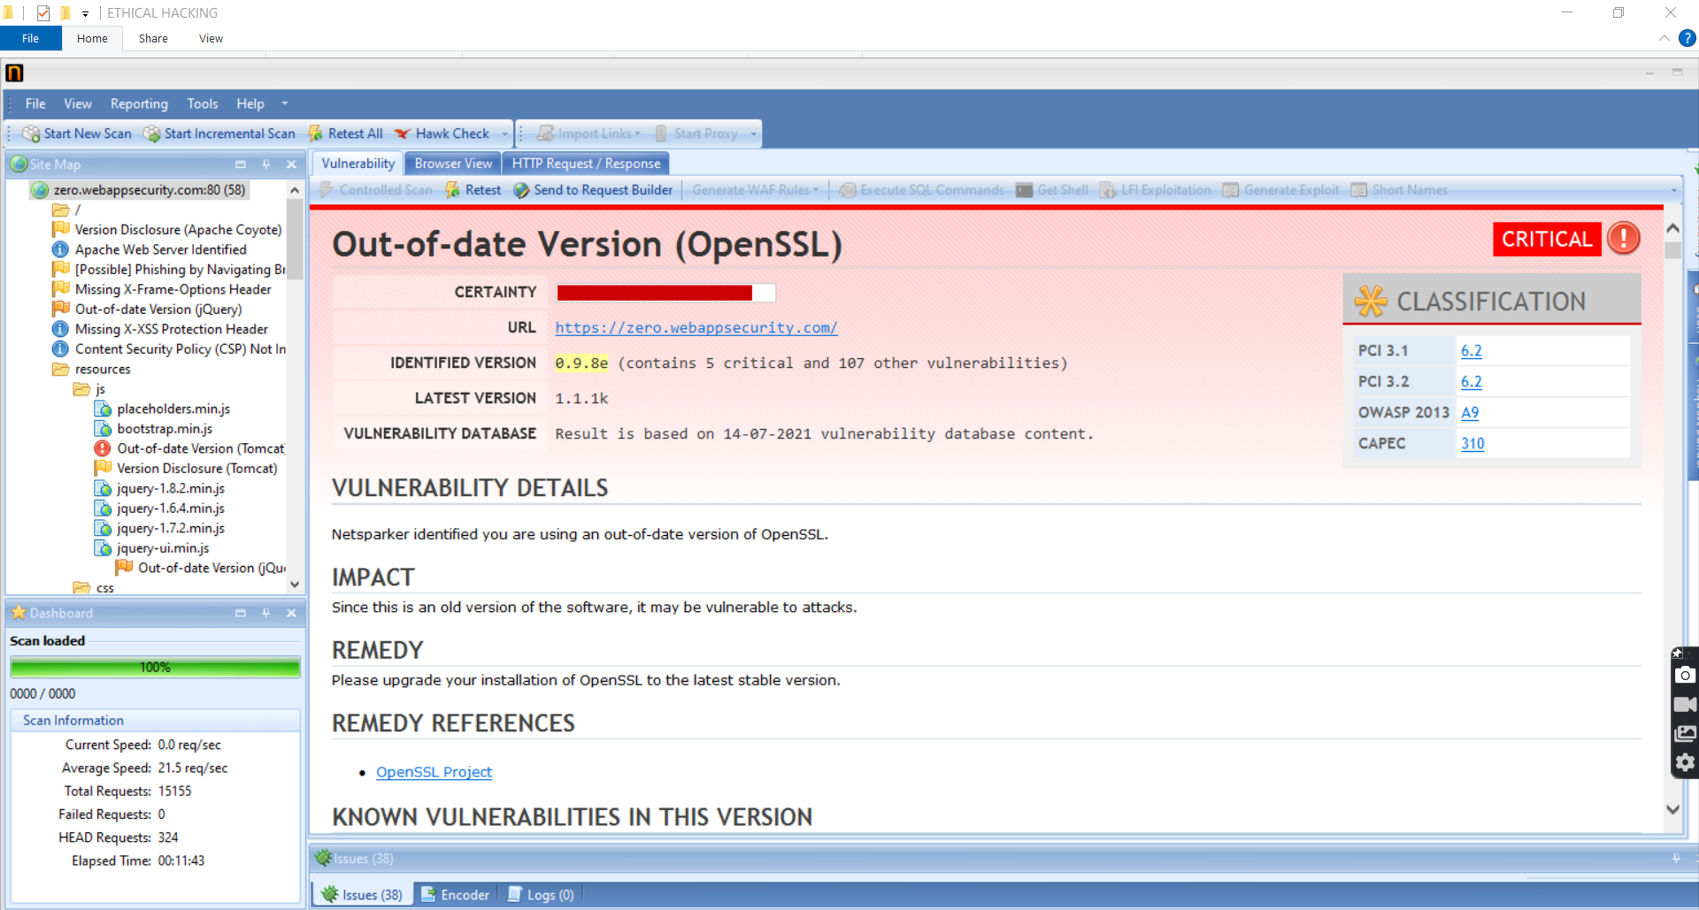
Netsparker Report For Out-of-date Version (OpenSSL)

Slide 4
My Report for Out-of-date Version (OpenSSL)
3 critical vulnerabilities:-
1.) Out-of-date Version (OpenSSL)
2.) Out-of-date Version (Apache)
3.) Out-of-date Version (Tomcat)

Slide 5
My Report for Out-of-date Version (OpenSSL)
URL :http://zero.webappsecurity.com/
Identified Version : 0.9.8e
Latest Version : 1.1.1k
Operating System : Kali Linux
Tools : Netsparker
Summary:-
Zero Bank's main website hhttps://zero.webappsecurity.com/ has an endpoint that is vulnerable as it has Out-of-date Version (OpenSSL) version 0.9.8e. As this is a old version of OpenSSL it is a critical threat to the website as an black hat attacker might take advantage of this. Also support for 0.9.8e has ended in 2006.
Impact:-
1.) A flaw in DTLS support - An attacker could create a malicious client or server that could trigger a heap overflow.
2.) A flaw was found in the SSL_get_shared_ciphers() utility function- An attacker could send a list of ciphers to an application that used this function and overrun a buffer with a single byte. Few applications make use of this vulnerable function and generally it is used only when applications are compiled for debugging
Remedy:-
Please upgrade your installation of OpenSSL to the latest stable version i.e. 1.1.1k

Slide 6
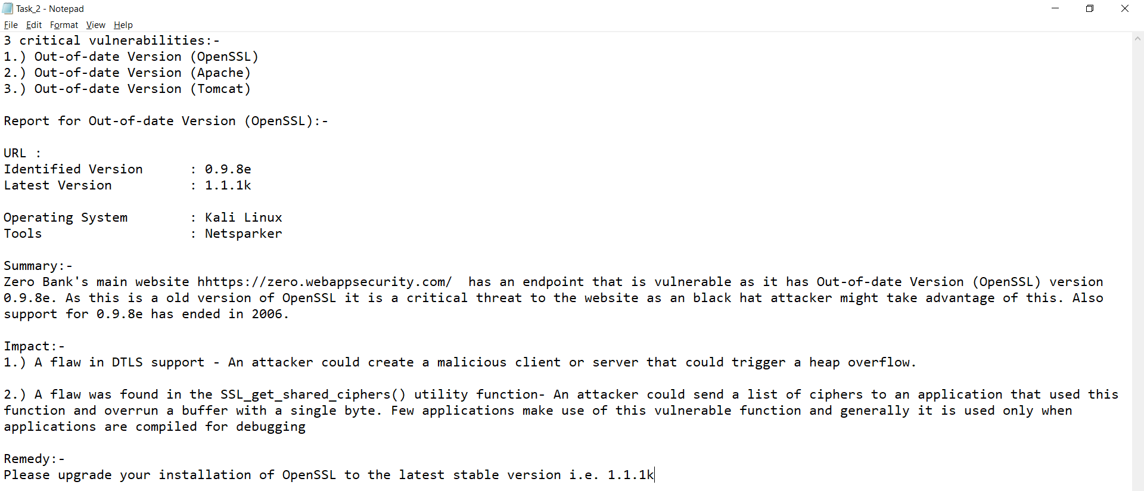
My Report for Out-of-date Version (OpenSSL) - Image

